Slide 1





NICE
NAVIGATING INTERPERSONAL COMMUNICATIONS & EMOTIONS

Slide 2





  Introduction
  Program Breakdown
  Workplace Culture
  Professionalism
  Emotional Regulation
  Groupwork
  NICE Nuggets
Agenda

Slide 3






NICE
WORKSHOP
Program Breakdown...
  30 Minute Workshop
  Trainer-Led
  Interactive Activities
  Focused Topics for All Food Service Staff
NICE
Facts,
Not Feelings
TLC
(Be Kind)
Mindful
Conflict
Resolution
De-escalation
In Action

Slide 4



Why talk about Navigating Interpersonal Communications and Emotions (NICE)?
Emotions can easily spread through a team, impacting overall mood and performance; positive emotions can boost morale, while negative emotions can create tension and decrease productivity.
Understanding how to navigate (recognize, understand, and manage) your own emotions as well as being mindful of others’ emotions can assist in developing a positive workplace culture. Practicing NICE fosters a sense of camaraderie and shared purpose in the workplace.

Slide 5




People may let emotions take over at work for a number of factors:
  stressful work environments
  personal issues spilling over into work
  lack of emotional intelligence
  not knowing how to manage emotions effectively
  poor coping mechanisms
  triggers related to specific situations or colleagues
This can lead to impulsive reactions instead of thoughtful responses.
EMOTIONS & COMMUNICATION
There is a strong and direct correlation with emotions and communication.
Emotional state significantly influences how we express ourselves verbally and nonverbally, impacting the message we convey and how it is received by others.

Slide 6


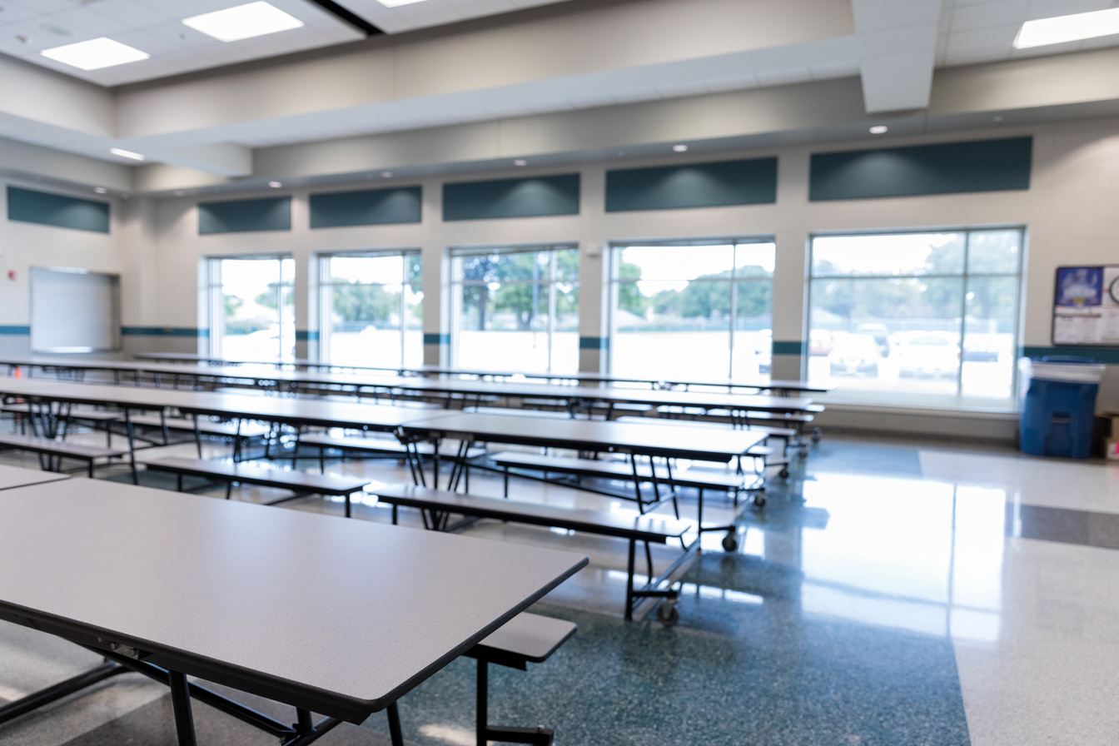

POSITIVE CULTURE
VALUES
WORKPLACE
CULTURE
Enhances employee satisfaction, but also accomodates various work styles, enabling everyone to work in ways that best suit their strengths and preferences.
Built on meaningful work, open communication, and strong core values, positive culture can attract and retain employees. Companies value people as their most important resource.
LEADERSHIP
EMPLOYEE EXPERIENCE
If leadership has both employee growth and shared values in mind, employees are more likely to do their best work. A strong leadership culture values transperency, accountability, and inclusivity.
Each employee interprets and feels differently based on interactions within the culture. This can vary based on their role, manager, and personal perspective.

Slide 7


GOOD ATTITUDE
BE TRUSTWORTHY
PROFESSIONALISM
Positivity is contagious, so stay positive to keep those around you positive. If you’re having a bad day, leave it at the door. Your feelings are valid, but they are not the responsibility of your direct supervisor and/or team, and should not effect your work.
If a task is given to you, get it done. Be receptive to feedback and constructive criticism. Be responsible for any actions you take and its potential consequences.
IMPROVEMENT
STRONG ETHICS
Everybody has room for improvement. Recognize and take those opportunities to grow. Grow through experience and self-development. Keep your skills up-to-date and valid as you grow in your work.
Follow code of conduct in your organization. Never perform any questionable acts within the organization and be the kind of person people can trust to do the right thing, no questions asked.

Slide 8


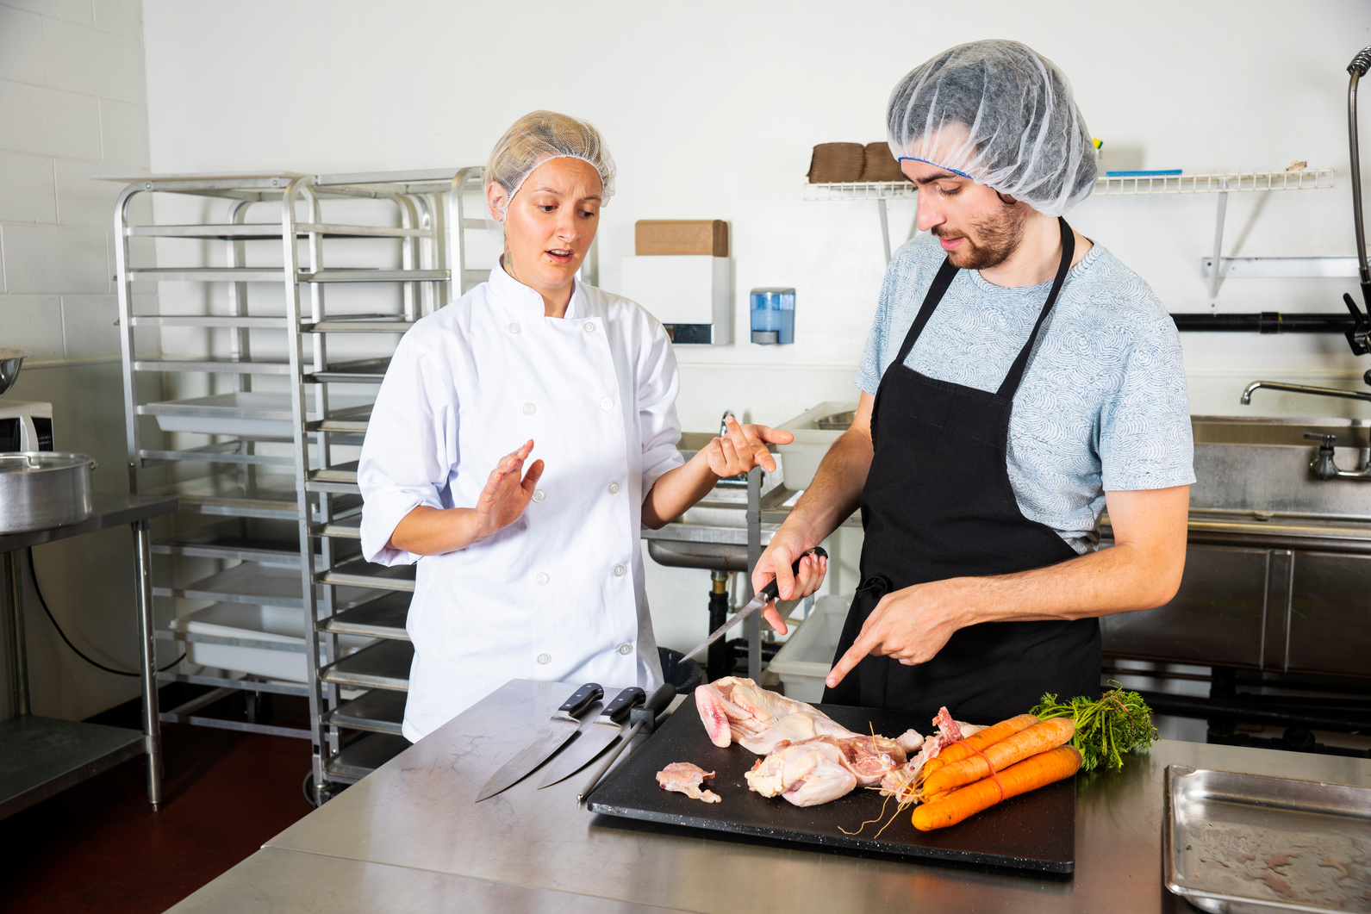

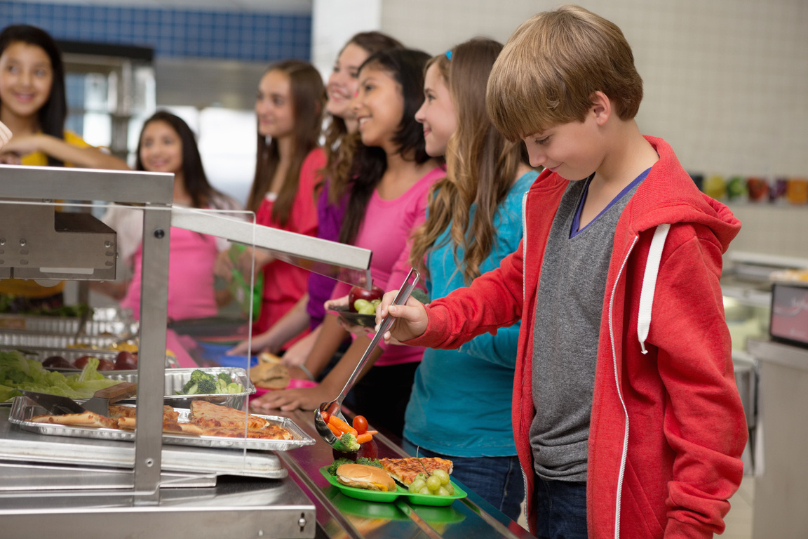
TYPES OF CONFLICT
MANAGER TO EMPLOYEE
EMPLOYEE TO EMPLOYEE
EMPLOYEE TO CUSTOMER
Majority of HR cases could have been handled if all parties involved had communicated tactfully.

Slide 9

FOOD SERVICE CHAIN*
It is within the scope of your direct supervisor to provide direction, ask questions, observe, and follow up within operational duties.
Regional Manager
  Provides general supervision to FSM and their staffs in the administration of food services programs in schools.
  Analyze financial data and cafeteria operations, determine inefficiencies and inconsistencies, and implement corrective action.
  Plans, directs, reviews, and supervises all food services operational, training, and human resources activities.
Area Supervisor
  Responsible for the supervision of a cafeteria operation for a variety of feeding programs.
  Supervise, train, and evaluate the work performance of food service employees.
Food Service Manager
  Assists a FSM by participating in the operation of a cafeteria by planning menus, preparing and serving meals, and giving work direction and training to cafeteria personnel.
  Prepares, produces, heats, cooks, and serves a variety of foods and assists in other related tasks in a designated food service production and/or service area.
  Supervision received from a FSM or other supervisor. Work may also be received from a Senior Food Service Worker.
Senior Food Service Worker
*Refer to your job classification duties for more detailed information.
Food Service Worker

Slide 10
WHAT IS
EMOTIONAL REGULATION?
EMOTIONAL REGULATION IS ACTIVELY MANAGING YOUR EMOTIONS IN THE WORKPLACE BY RECOGNIZING YOUR TRIGGERS, IDENTIFYING YOUR FEELINGS, AND USING COPING MECHANISMS TO RESPOND CALMLY AND APPROPRIATELY TO SITUATIONS, ALLOWING YOU TO MAINTAIN A PROFESSIONAL DEMEANOR AND PERFORM EFFECTIVELY DESPITE STRESSORS.

Slide 11
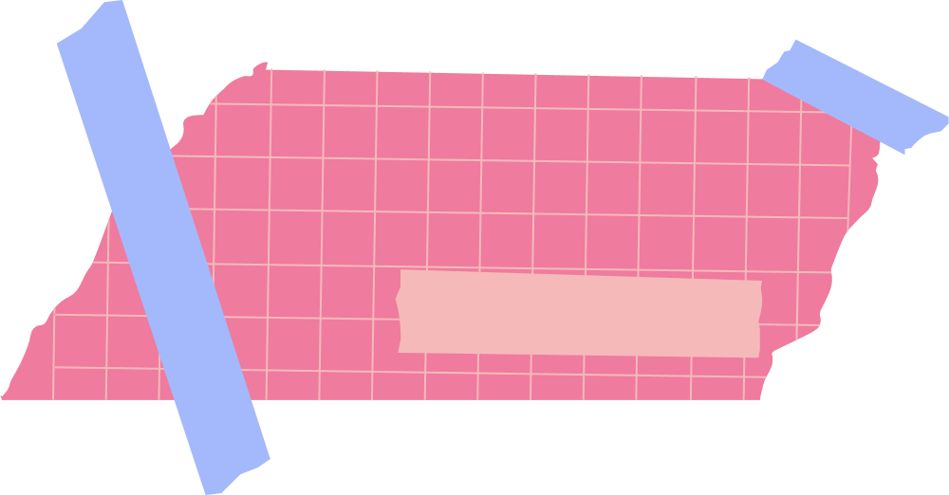
Practicing
Reduce the INTENSITY of reactions by practicing mindfulness and identifying what you can and cannot control.
Emotional Regulation
NOT IN MY CONTROL
IN MY CONTROL
  the past
  the future
  opinions of others
  what other people think of me
  my boundaries
  my thoughts and actions
  goals I set
  how I speak to myself
  what I give my energy to
  how I handle challenges

Slide 12





Let’s Hear It!
EMPLOYEE HANDBOOK VIOLATIONS
ACTIVITY INSTRUCTIONS
TEAMWORK
PRODUCTIVITY
Each group (6) will take turns moving from poster to poster and write down issues and challenges per each category
1
Groups will have 2 minutes to write down all issues per each poster and then move to next
2
DERELICTION OF DUTY
STUDENT INTERACTIONS
COMMUNICATION
3
As a class, let’s discuss the issues after all rounds are completed

Slide 13


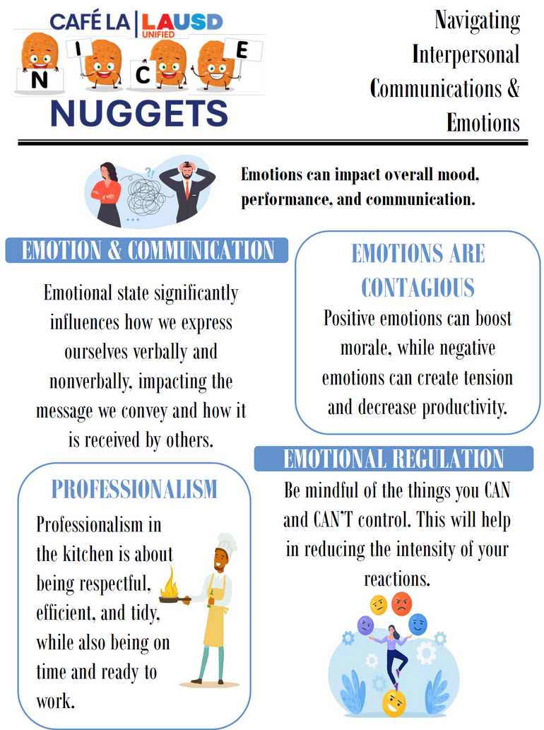
Share and read aloud the “NICE NUGGETS” poster with your staff.
Post it in a visible area for your staff to review as they please.

Slide 14
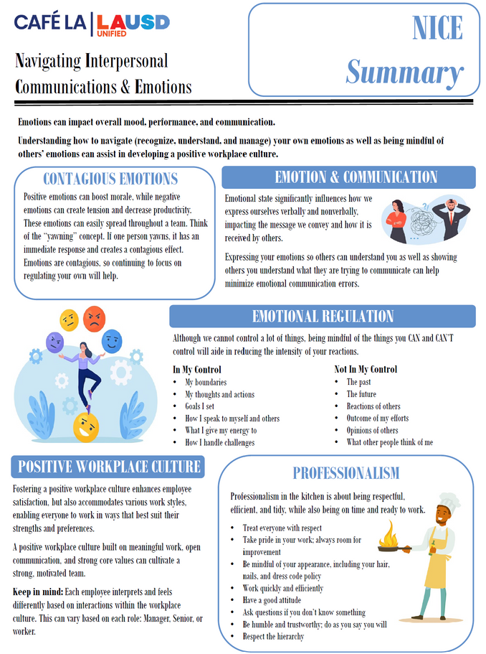
THANK
YOU!
Please enjoy the summary handout and retain throughout the NICE Workshop Program in your 3-ring binder!

